Slide 1
Mary Ward
Foundress of Loreto

Slide 2
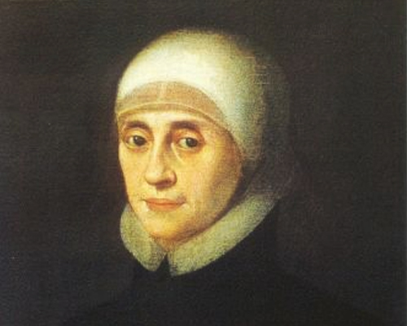
Mary Ward 1585 - 1645
“Women in time to come will do much”

Slide 3
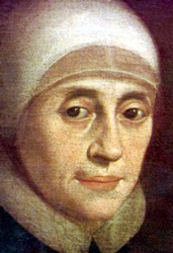
Early Life
Mary Ward, an intrepid Yorkshire woman was born in 1585, into an England ravaged by religious war. At the time even going to mass was considered an offence against the state. As a young woman Mary followed her desire for religious life and joined the Poor Clare community in St Omer in Flanders (now northern France).

Slide 4
Her Calling….
However, it quickly became apparent to her that God was asking “some other thing” of her, and Mary returned to London. Here she worked tirelessly caring for the sick, visiting prisoners and supporting those struggling with their faith. A number of young women joined her.
Towards the end of 1609 Mary and five companions left London for St Omer and began a school mainly for English emigrants.

Slide 5
Her Life’s Work
In 1611, Mary began her work to establish an Institute for women based on the life established by St Ignatius of Loyola for the Jesuits. Mary’s motto was,
“Women in time to come will do much”.
Through her life she pioneered the higher education of Catholic women. During her own life time, she established schools all over Europe.

Slide 6
The Present Day
At the present day, her Institute is spread over the five continents.
The Irish branch of the Institute was founded in 1821 by Frances Ball, a native of Dublin. Her first foundation was at Rathfarnham and was called Loreto Abbey, from which title the members became known as Loreto Sisters and all subsequent foundations at home and abroad were called Loreto.
Loreto Secondary School, Balbriggan was established in 1857.

Slide 7
Church Recognition
On 19th of December 2009 His Holiness Benedict XVI formally conferred the title “Venerable” on Mary Ward for all her heroic work.

